Slide 1

Water Borne Diseases in
Flood Times
Prof. Dure Samin Akram
Hon. Chairperson
Health Education & Literacy Programme
7th Karachi International Water Conference
HISAAR FOUNDATION
Karachi.
28TH. Oct. 2025.
Prof. Dure Samin Akram
Hon. Chairperson
Health Education & Literacy Programme
7th Karachi International
Water Conference
28th & 29th October 2025

Slide 2
Session Objectives:
To unpack the drivers of Pakistan’s high burden of water-borne diseases—such as contaminated drinking water, floods, urban water insecurity, and weak surveillance.
Promote Health System Integration on water-borne disease prevention into Pakistan’s public health systems, focusing on surveillance, diagnostics, and treatment capacity.
To formulate a model for rapid-response public-private partnerships to address water contamination crises in urban and rural settings.

Slide 3
Presentation Outline
Water and Sanitation and its effects in Pakistan
Climate Change and Floods/Provincial Risks
Water Borne Diseases during Floods
Role of Frontline Workers during Floods
Water Surveillance
Possible Actions

Slide 4

Water Quality and Access
Only 20% of Pakistan’s population has access to clean drinking water.
Widespread contamination with fecal coliforms in 58–71% of samples.
Poor sanitation and mixing of sewage with drinking water systems.
Contamination with chemicals factory waste, pesticides and high saline and mineral content
Notes:
The rural population in Baluchistan and Tharparkar in Sindh, Cholistan in Punjab have difficulty in accessing water.

Slide 5
Water, Sanitation and its effects in Pakistan
Epidemiological Burden
Pakistan faces a severe challenge in providing safe drinking water.
Over 68% of diseases in children in Pakistan are related to unsafe drinking water (WHO, 2024).
Over 30% U5 children suffer from a diarrheal episode, annually (more in 0-23 months children)
Approximately 53,000 deaths annually in <5 children are attributed to water-borne illnesses.
This translates to 16% of child deaths due to diarrhea
Pakistan has the highest rate of mortality attributable to diarrhea among South Asian nations
Rural and low-income populations are disproportionately affected.
Lack of hygiene awareness and poor water storage practices aggravate risks.

Slide 6
Data and Impact
In early 2024, 1.8 million cases of acute watery diarrhea were reported, with rising AMR rates
High medical costs and productivity losses due to illness.
Children under five suffer recurrent diarrhea leading to malnutrition
44% stunting due to infections and food insecurity
Estimated annual economic loss: USD 380–880 million.

Slide 7
Floods 2022 in Pakistan
During the summer of 2022, one-third of Pakistan experienced flooding, displacing 33 million people and affecting 16 million children
Led to catastrophic and multi-sectoral destruction of property and infrastructure, causing mass displacement and disruption of life for those affected.
The adverse impacts of flooding on human health are multifaceted
1346 sanitation facilities destroyed,5714 partially damaged.
increase in the rates of mortality and morbidity caused by diarrheal illnesses
These disasters resulted from broken to nonexistent toilets, stagnant water, contaminated water wells, damaged roads, and inaccessible transportation services.
Tasks dependent on WASH facilities caused significant mental distress.
Risk factors (P > 0.05) for diarrhea in flood-affected areas include illiterate mothers, flooding, large family size, households without livestock, poor water quality, untreated water, and lack of toilet facilities.(Ref:Am. J. Trop. Med. Hyg., 110(2), 2024, pp. 323–330)

Slide 8
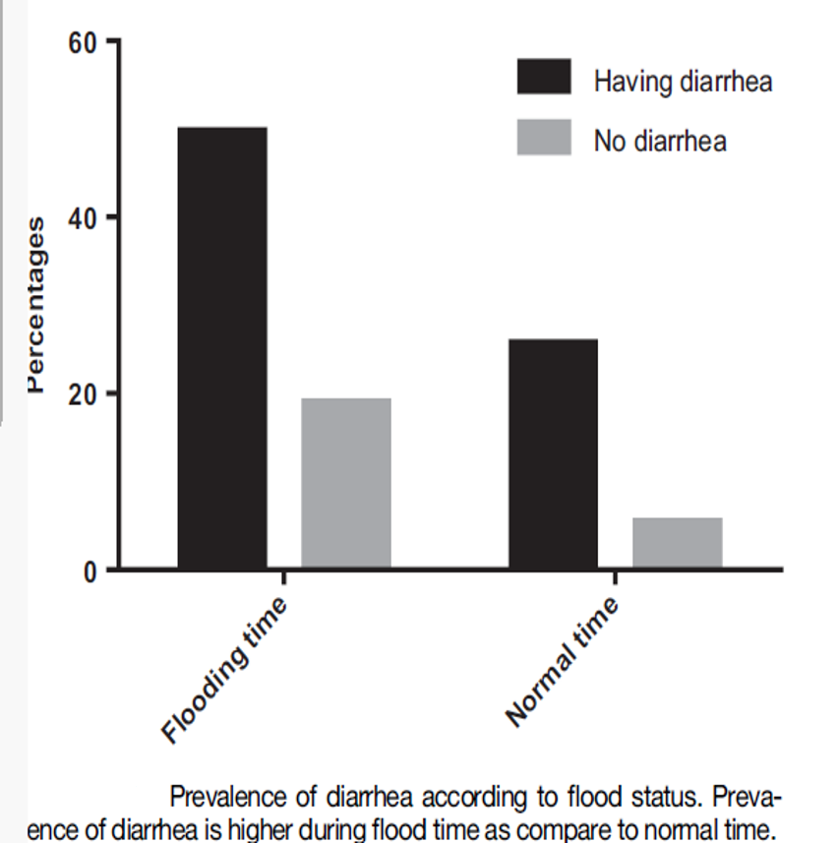
Am. J. Trop. Med. Hyg., 110(2), 2024, pp. 323–330
Diarrheal episodes in Children. Data from KP during Floods 2022.

Slide 9

Climate Change and Flood Risk in Pakistan
.
Pakistan is in ‘the Eye of the Storm’ for Climate Change
Floods in 2022 affected 33 million people with 7.9 million displaced
About 10 % of the country’s land area was significantly affected (flooded or inundated)-Sindh was more affected (18% of land inundated) .
Frequency of flooding will increase over time.
“Flooding will be ‘new normal for Pakistan’” (Dawn)
The probability of a flood occurrence in a five-year flood is 20%, which may cause the country's GDP about $20.4 billion, with 8.4 million population at risk and $1.4 billion urban damage.(modelled).*
*Envirn Sci Pollut Ress
2021 Jun;28(23):29720-2973

Slide 10
Flood Risk in Provinces
Flood frequency & intensity increasing across all provinces
Punjab(61% area at risk), & Sindh(74% area hi risk): Highest exposure (population & economic risk)
KPK, GB, AJK: Flash Floods/ Glacial lake outbursts(GLOFS)
Baluchistan: 33%of population at risk: high downpours, poor drainage

Slide 11
Water Borne Diseases during Floods
Floodwaters contaminate drinking sources with sewage and waste.
Sanitation systems break down, increasing exposure to pathogens.
Stagnant water becomes a vector breeding ground.
Health services are disrupted, delaying response.
Crowded shelters reduce access to safe water and hygiene.

Slide 12
Common Water-Borne Diseases During Floods
Cholera – from Vibrio cholerae via contaminated food/water.
Typhoid fever – caused by Salmonella typhi through fecal contamination.
Hepatitis A & E – spread via ingestion of contaminated water.
Acute diarrheal diseases – from E. coli, Shigella, etc.
Leptospirosis – contact with floodwater contaminated by animal urine.
Giardiasis and Cryptosporidiosis – protozoan infections.
Chemical contamination, pesticides, arsenic, industrial waste (urban), affecting health
Notes:
Describe the main diseases, focusing on their transmission sources and symptoms briefly.

Slide 13
Pathways of Transmission
Ingestion of contaminated drinking water.
Consumption of food prepared with unsafe water.
Direct contact with floodwater.
Person-to-person spread due to poor hygiene.
Notes:
Explain how these transmission routes are intensified during flooding conditions.

Slide 14
Vulnerable Populations
Children under five years.
01
Pregnant women and elderly persons.
02
Immunocompromised individuals.
03
Displaced communities in temporary shelters.
04
Notes:
Highlight who is most affected and why – emphasize children’s vulnerability due to dehydration risk.

Slide 15
Immediate Health Impacts
Outbreaks of diarrhea, cholera, typhoid and hepatitis after floods.
Increased child mortality due to dehydration.
Overwhelmed health facilities.
Disrupted vaccination and surveillance systems.
Notes:
Stress the rapid and severe nature of outbreaks following floods.

Slide 16
Climate Change and Future Preparedness
More frequent floods increase water-borne disease risk.
Need for climate-resilient water and sanitation infrastructure.
Integration of water safety and disease control into emergency policies.
Notes:
Connect flood-related disease control to broader climate resilience and policy integration.

Slide 17
Prevention and Control Measures
Ensure safe water: boiling, chlorination, or treatment kits.
Temporary latrines and proper waste disposal.
Handwashing and hygiene promotion.
Vaccination for cholera,typhoid,Rota and hepatitis A
Community health education.
Notes:
Summarize preventive strategies and their importance in emergency settings.

Slide 18

Discussion

Slide 19
Provocations
How are climate shocks like floods directly worsening water-borne disease outbreaks?
Why is water quality surveillance so weak and how can it be strengthened on scale?
What is the specific role of frontline health workers in early detection and prevention?
How can partnerships with private sector and academia accelerate innovation (e.g., low-cost filters, AI)?
How can public health systems improve surveillance without relying only on WASH?
What role can climate-resilient health policies play in mitigating flood-related disease?
What enforcement mechanisms are needed to make water quality results legally actionable?
If WASH in clinics is a national emergency, what is the first piece of infrastructure to fund and why?

Slide 20
Frontline Health Workers’ Role in Early Detection & Prevention
Conduct rapid risk assessments during floods.
1
Report diarrheal disease clusters quickly.
2
Mobilize local cleanup and hygiene campaigns.
3
Educate communities on safe water and hygiene.
4
Distribute ORS, chlorine tablets, and hygiene kits.
5
Support cholera, typhoid Rota and vaccination drives.
6
Notes:
Frontline health workers are key for early warnings and education in flood-hit areas.

Slide 21
Government and System-Level Response
Rapid water testing and public health advisories.
Emergency WASH supplies, proactively.
Strengthen disease surveillance systems.
Coordination across health, water, and disaster sectors.
Public communication for prevention and early care-seeking.
Notes:
Discuss the importance of preparedness, coordination, and information dissemination.

Slide 22
Infrastructure and Systems. Recommendations:
Ref: AN EXPLORATORY STUDY ON THE IMPACT OF 2022 FLOODS. Kainat Khurshid,et.al. 2024.
Early warning systems, protocols, and services to reduce damage to life and property.
WASH infrastructure that can facilitate women, which considers the cultural norms and safety concerns of local contexts.
Long-term plans to secure flood protection walls and dams strategically to minimize damage to crops and property.
Policies and guidelines around the development of innovations on local lands, such as assessing the long-term impacts of non-indigenous plant species, technology-based large-scale farming practices, construction of infrastructure around natural ecosystems

Slide 23
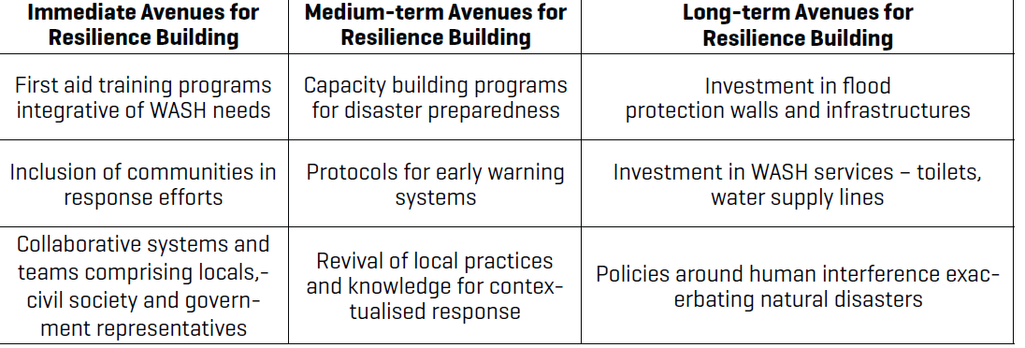
Preparedness for Future Disasters
Ref. Floods 2022: Kainat Khurshid, et.al. 2024.

Slide 24
Private Sector & Academia Partnerships for Innovation
Private sector: low-cost filters, mobile labs, solar purification.
Academia: AI models and pathogen detection research.
Nano-tube filters and water purifiers.
Joint innovation hubs for WASH technologies.
Open challenges for scalable, community-based solutions.
Notes:
Public-private-academic collaboration accelerates access to affordable water safety innovations.

Slide 25
Strengthening Water Quality Surveillance
Presently, limited labs, staff, and data sharing between sectors
.
Infrequent sampling and lack of real-time data.
Therefore, use portable test kits and mobile reporting tools.
Integrate testing into disease surveillance systems.
Establish regional labs and public dashboards.
Notes:
Water surveillance is often fragmented. Strengthening requires decentralization, technology integration, and transparency.

Slide 26

Public Health Surveillance Beyond WASH
Surveillance should combine environmental and health data
Link climate, environmental, and health data systems.
Use GIS-based dashboards to detect hotspots.
Expand community surveillance networks.
Adopt approaches for integrated risk detection.
Notes:
Surveillance should combine environmental and health data for predictive response capacity.

Slide 27
Climate-Resilient Health Policies for Disease Prevention and Management
Climate risk assessments should become part of all health projects.
Design flood-proof, water-secure health facilities.
Include disease preparedness in emergency plans.
Ensure rapid availability of funds for disaster and post-disaster recovery
Notes:
Climate-resilient policies ensure that health systems withstand floods and protect populations.

Slide 28
Mechanisms for Water Quality Accountability
Legally binding water quality standards as per WHO standards
.
Mandatory public disclosure of water test results.
Penalties and suspensions for non-compliance.
Empower citizens for local monitoring.
Notes:
Legal enforcement ensures that water safety is upheld through accountability and transparency.

Slide 29
WASH in Clinics: The First Infrastructure Priority
Fund reliable, protected water supply systems first.
Build Climate and Flood Resilient Facilities for Health Care
Essentials for all infection prevention measures.
Build community trust and service credibility.
Notes:
Water supply is the foundation of safe, climate-resilient healthcare facilities. Sanitation and waste management follow.

Slide 30

ARE WE READY?

